Slide 1
High-Throughput I/O Queues
head
head
tail
tail
SQ metadata
queue head
queue tail
ticket counter
SQ
CQ
0、2...
turn counter array
mark array (bit)
lock
turn counter
0
0
0
0

Slide 2
High-Throughput I/O Queues
head
head
tail
tail
SQ metadata
queue head
get the lock
queue tail
ticket counter
SQ
CQ
0、2...
turn counter array
mark array (bit)
lock
submit request
turn counter
0
0
0
0

Slide 3
High-Throughput I/O Queues
head
head
tail
SQ metadata
queue head
queue tail
ticket counter
SQ
CQ
0、2...
turn counter array
mark array (bit)
lock
tail
turn counter
1
1
1
1

Slide 4
High-Throughput I/O Queues
head
head
tail
SQ metadata
queue head
queue tail
ticket counter
SQ
CQ
0、2...
turn counter array
mark array (bit)
lock
tail
turn counter
Ring the doorbell !!
1
1
1
1

Slide 5
High-Throughput I/O Queues
head
head
tail
SQ metadata
queue head
queue tail
ticket counter
SQ
CQ
0、2...
turn counter array
mark array (bit)
lock
tail
turn counter
1
1
1
1

Slide 6
High-Throughput I/O Queues
head
tail
SQ metadata
queue head
queue tail
ticket counter
SQ
CQ
0、2...
turn counter array
mark array (bit)
lock
head
tail
turn counter
1
1
1
1

Slide 7
High-Throughput I/O Queues
head
tail
SQ metadata
queue head
queue tail
ticket counter
SQ
CQ
0、2...
turn counter array
mark array (bit)
lock
head
tail
SQ head = 4
turn counter
Ring the doorbell !!
1
1
1
1

Slide 8
High-Throughput I/O Queues
head
tail
SQ metadata
queue head
queue tail
ticket counter
SQ
CQ
0、2...
turn counter array
mark array (bit)
lock
head
SQ head = 4
tail
turn counter
1
1
1
1

Slide 9
High-Throughput I/O Queues
tail
SQ metadata
queue head
queue tail
ticket counter
SQ
CQ
0、2...
turn counter array
mark array (bit)
lock
head
head
SQ head = 4
tail
turn counter
2
2
2
2

Slide 10
BaM cache
cache
thread1
cache
cache
thread2
cache
__match_any_sync
cache
thread3
cache
cache
thread4
cache
cache
thread5
cache
Warp Coalescing

Slide 11
BaM cache
cache
thread1
leader
cache
cache
thread2
cache
__match_any_sync
cache
thread3
cache
cache
thread4
cache
cache
thread5
cache
Warp Coalescing

Slide 12
BaM cache
cache
thread1
leader
cache
cache
thread2
cache
__match_any_sync
cache
thread3
cache
cache
thread4
cache
cache
thread5
cache
Warp Coalescing

Slide 13
BaM cache
leader
cache
thread1
cache
cache
thread2
cache
__match_any_sync
broadcast
cache
thread3
cache
cache
thread4
cache
cache
thread5
cache
Warp Coalescing

Slide 14

BaM: Life of a GPU Thread
GPU Application CUDA Thread
val = data[idx];
1
Update SQ/CQ head
9
Wait for doorbell
Offset Calc
A
hit
2
Update cache state
8
Read SQ from GPU
B
Warp Coalesce
Poll for completion
7
C
Process CMD
F
3
read(off, ...)
Submit CMD to SQ
DMA write to GPU I/O buffer
6
D
Cache lookup
4
Prepare CMD
5
E
Write CQ in GPU mem
miss(off)

Slide 15
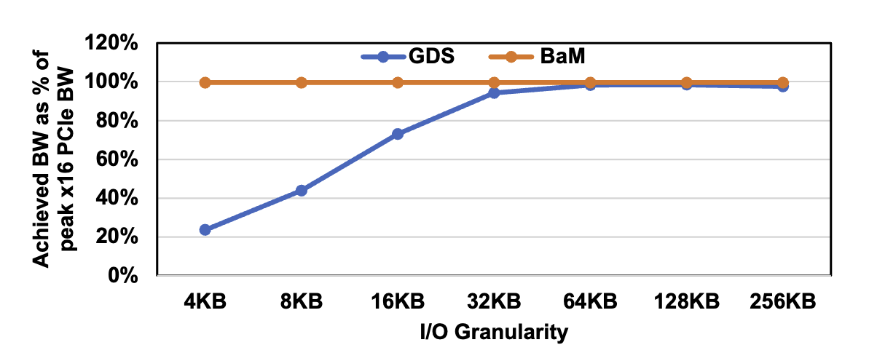
BaM VS GDS
GDS can only saturate the GPU’s PCIe link at the large I/O granularity of 32KB and only reaches 23.6% of the PCIe bandwidth at 4KB.
In contrast, BaM easily achieves 25GBps using four SSDs, which is the measured peak bandwidth of the GPU’s PCIe link

